Slide 1
Case Study Jayavignesh G
Question
Arielle and Boris compete in the little-known sport of pancake flipping, and have both been nominated for this season's "best pancake flipper" award.
Half the people in the pancake flipping league office think Arielle is the better pancake flipper, and the other half think Boris is, so they have retained a data scientist to help solve the issue.
The stats from this season are attached. The columns are:
the contestant's name,
the match day,
which hand they used to flip the pancakes,
their score (how many pancakes they flipped successfully), and
how many total pancakes they attempted to flip
Is Arielle or Boris the better pancake flipper? Justify your decision. Do both sides have a case here?

Slide 2
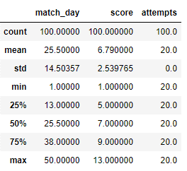
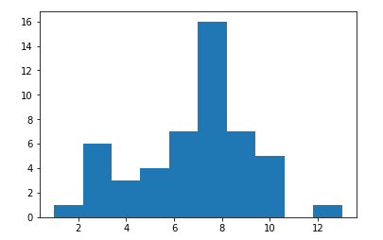
Initial Data Analysis:
The data looks well diverse and following a normal distribution. Below are some analysis done in Python.

Slide 3
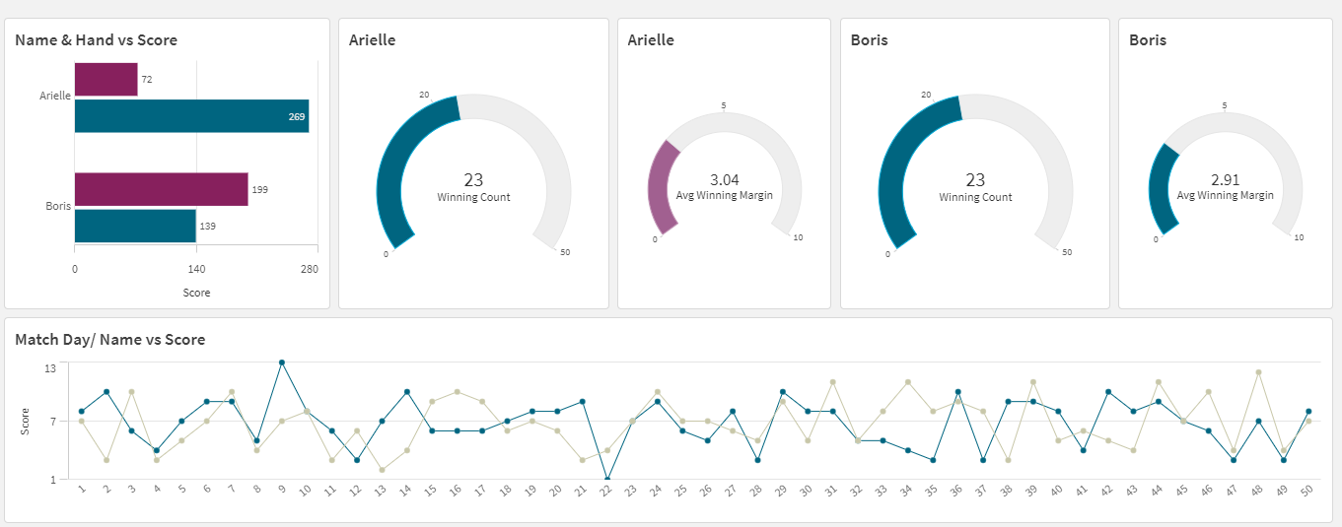
Descriptive Analysis using Qlik Sense: At a first glance Arielle seem to have scored 341 out of 100 attempts whereas Boris have scored little less 338 out of 100 attempts. The success margins are also high for Arielle than Boris.

Slide 4
Key Dimension – Hand: From below, both Arielle and Boris seem to be strong at right hand as they have high winning margins in same. So we can make an assumption as ‘right hand’ is a dominant hand for both Arielle and Boris.
Row Labels | Sum of attempts | Sum of score | %
Arielle | 1000 | 341 | 34.10%
L | 300 | 72 | 24.00%
R | 700 | 269 | 38.43%
Boris | 1000 | 338 | 33.80%
L | 700 | 199 | 28.43%
R | 300 | 139 | 46.33%
Grand Total | 2000 | 679 | 33.95%
Type | Sucess Rates by Hand |  | Diff
 | Arielle | Boris
Left | 24.00% | 28.43% | 4.43%
Right | 38.43% | 46.33% | 7.90%
Diff | 14.43% | 17.90%
Type | Sucess Rates #attempts
 | Arielle | Boris | Diff
300 attempts | 24% | 46% | 22%
700 attempts | 38% | 28% | 10%
Diff | 14% | 18%

Slide 5
Assumption : Both play by dominant hand (Right)
If Boris have played more attempts in right hand, below would be the results considering the success rates are true. From below, it is evident that Boris is a better player than Arielle.
Right Hand (700 attempts) | Score | Attempt
Arielle | 269 | 700
Boris | 324 | 700
Diff | 55
Left Hand (300 attempts) | Score | Attempt
Arielle | 72 | 300
Boris | 85 | 300
Diff | 13
Right Hand (1000 attempts) | Score | Attempt
Arielle | 380 | 1000
Boris | 460 | 1000
Diff | 8%
Left Hand (1000 attempts) | Score | Attempt
Arielle | 240 | 1000
Boris | 280 | 1000
Diff | 4%

Slide 6
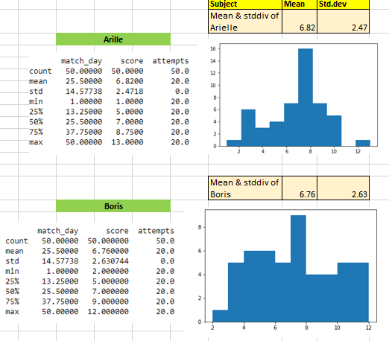
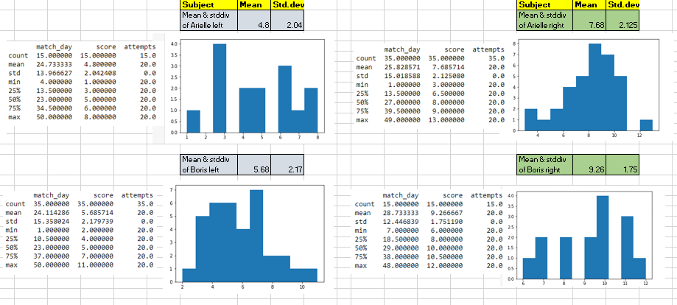
Distribution’s by Hand as dimension: The analysis using Python pandas also confirms the same as below. Boris has strong higher ranges than Arielle.

Slide 7
Inference :
The season's "best pancake flipper" award goes to
      Boris

Slide 8
Thank you!

